Slide 1


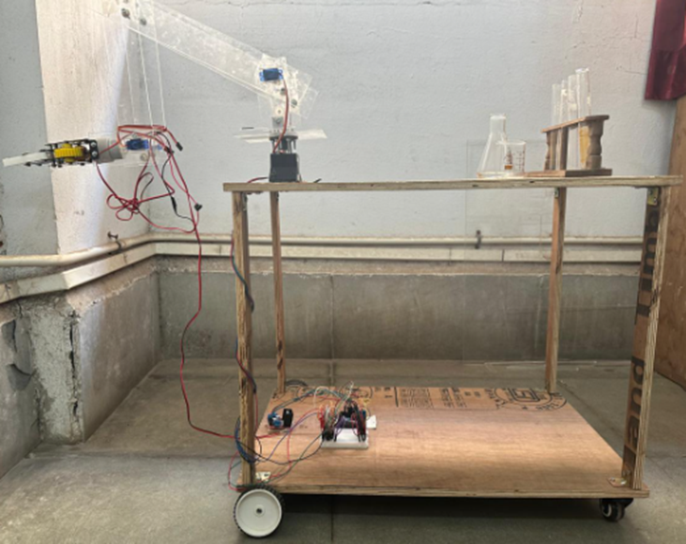
Material Handling Robot
LY Project by
Atharva Srivastava - 16010520086
Saurabh Rane - 16010520089
Amod Zack - 16010520102

Slide 2
Abstract
Material Handling is a concept used to describe the movement of materials, especially, raw goods from one point to another as per the process involved in the workplace.
This project report dives deep into how robots that handle materials, automated systems, and the Internet of Things (IoT) work together.
The results reveal significant improvements, such as increased productivity and accuracy, decreased reliance on human effort, and an improved work environment.

Slide 3
Problem Statement
In the new era of Industry 4.0, the emergence of the concept of automation has been a big achievement. Its applications in various industries have shown fruitful results. Robotics has means by which automation can be introduced in these industries.
Using robots to perform tasks such as handling of materials can increase efficiency, reduce costs and time consumption along with creation of a better work environment.
The aim here is to design and implement an efficient material handling robot to optimize logistics and streamline operations in industrial settings like laboratories and similar facilities.

Slide 4
Introduction
The basic purpose of this robot is to handle and transport lightweight objects or apparatus such as test tubes, beakers, syringes, etc. that are generally found in laboratories or hospitals.
It simply performs the pick and place operation essential in material handling. With emerging technologies like IoT, the use of Arduino microcontroller, Bluetooth, etc. the robot can also be operated using an Android smartphone with the programming behind this robot enabling wireless connectivity.
Such technologies are the part of the fourth phase of industrial revolution, which has a vision to introduce automation in the industries. The applications of this robot are not limited only to one industry but many others as well.

Slide 5
Objectives
To build a material handling robot that will handle materials such as test tubes and similar apparatuses.
To design an arm for the robot that will manipulate the materials by performing pick and place operations.
To create a mobile body for the robot with a cart-like structure that has wheels and will transport the material.
To synchronize motion and simulate robot using a Bluetooth (HC-05) module, operating via a smartphone.

Slide 6
Literature Survey
Title | Author | Description
Simulation-Optimization of Automated Material Handling Systems in a Healthcare Facility (2020) | Bhosekar et al. | Automated material handling systems are used in healthcare facilities to optimize material flow, minimize workforce requirements, reduce the risk of contamination, and reduce injuries. This study proposes a framework that integrates data analysis with system simulation and optimization to address the following research questions: (i) What are the implications of redesigning a hospital's material handling system? (ii) What are the implications of improving a hospital's material handling process?
Design and Implementation of Intelligent Material Handling Robot Based on STM32 (2021) | Lu et al. | In order to improve the efficiency of logistics handling and save labor costs, this project designs an intelligent material handling robot based on STM32. The experimental results show that the design can realize the functions of autonomous tracking positioning, autonomous handling, visual recognition, remote control and so on. It meets the basic requirements of the design and has a certain reference value in practical application.
Modeling, analysis, and performance evaluation of a robotic gripper system for limp material handling (1998) | Kolluru et al. | This paper presents an analytical model of a flat surfaced robotic gripper designed to automate the process of reliable, rapid and distortion-free limp material handling. The designed gripper prototype is integrated with an industrial robot manipulator. Performance of the overall system is experimentally tested, based on a set of industry dictated operational constraints.
Materials-handling systems: Automating of materials handling can integrate otherwise isolated islands of automated machine tools (1983) | Bradt and Alfred | To function at their full potential, expensive and highly automated production machines have to be integrated into systems. Work in process has to be transported quickly and reliably from one work station to the next, and stored workpieces must be easily accessible.
Challenges for SMEs entering the IoT world: success is about so much more than technology (2017) | Nylander et al. | We describe a case in which a small company with no competence in the Internet of Things has attempted to develop a connected product. Many of the issues that have come up around this process are not centered around the technology or the technical solution. Instead, the IoT brings additional challenges connected to the change of the customer-provider relationship, the need for a new business model, the need to understand the IoT ecosystem to make a product fit in, and the challenge of getting access to all the different competences needed.

Slide 7
Literature Survey
Title | Author | Description
Robots in Healthcare (2023) | Kim | Robots not only assist during surgeries, they also help healthcare professionals in other aspects from sanitizing hospitals during pandemic to teaching social skills to children with autism.
Internet of Things Meets Robotics: A Survey of Cloud-based Robots (2023) | Eze | This work presents a survey of existing literature on the fusion of the Internet of Things (IoT) with robotics and explores the integration of these technologies for the development of the Internet of Robotics Things (IoRT). The survey focuses on the applications of IoRT in healthcare and agriculture, while also addressing key concerns regarding the adoption of IoT and robotics.
Internet of Things and Robotics in Transforming Current-Day Healthcare Services (2021) | Pradhan et al. | Technology has become an integral part of everyday lives. Recent years have witnessed advancement in technology with a wide range of applications in healthcare. However, the use of the Internet of Things (IoT) and robotics are yet to see substantial growth in terms of its acceptability in healthcare applications. The current study has discussed the role of the aforesaid technology in transforming healthcare services. The study also presented various functionalities of the ideal IoT-aided robotic systems and their importance in healthcare applications.
Internet of Robotic Things: Current Technologies, Applications, Challenges and Future Directions (2021) | Villa et al. | Nowadays, the Internet of Things (IoT) concept is gaining more and more notoriety bringing the number of connected devices to reach the order of billion units. Its smart technology is influencing the research and developments of advanced solutions in many areas. This paper focuses on the merger between the IoT and robotics named the Internet of Robotic Things (IoRT). Allowing robotic systems to communicate over the internet at a minimal cost is an important technological opportunity. Robots can use the cloud to improve the overall performance and for offloading demanding tasks.
Cloud and IoT Applications in Material Handling Automation and Intralogistics (2020) | Ponis and Efthymiou | Industry 4.0, the new industrial revolution, is merging the physical, digital and virtual worlds through emerging technologies that collide with each other and create a distinctive paradigm shift. Even though the topic of Industry 4.0, has attracted significant attention during the past few years, literature in this subject area is still limited. The main objective of this paper is to study the current state of the art and identify major trends and research shortcomings.

Slide 8
Methodology
The project methodology is focused on extensive research of robots and their applications.
The design phase of the robot involved research studies, online resources and informative videos, culminating in the selection of a system that perfectly meets the needs of our project, especially our choice of robot model.
The robotic design is ready to efficiently handle and transport products according to specific requirements and shows that it can be an asset to increase efficiency and accuracy.

Slide 9
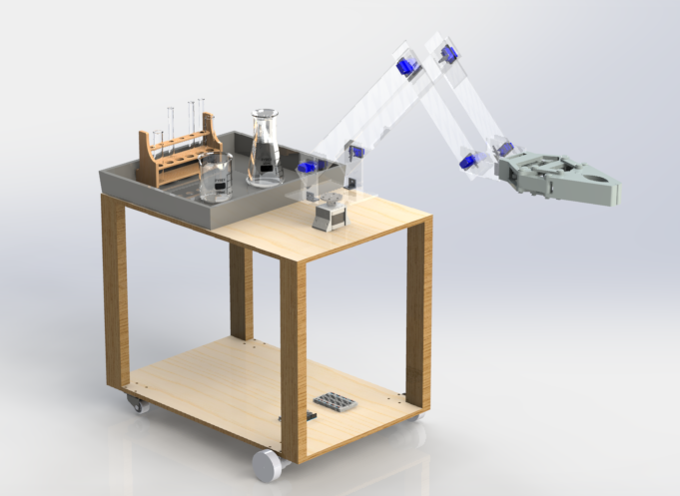
Design

Slide 10
Components
The envisioned robot features a streamlined structure comprising three main components: a mobile body, a dedicated handling equipment, and a robot arm with a four-degree-of-freedom (DOF) model and a two-claw motorized gripper as the end effector. Controlled by a NEMA 17 stepper motor and servo motors, the arm is attached upright to the mobile body, which is equipped with four wheels—two motor-operated at the front and two trolley wheels at the rear.
The entire assembly operates under the principles of the Internet of Things (IoT), with an Arduino UNO R3 board as the central control unit. Bluetooth connectivity enables remote control, utilizing a device like a smartphone as a teaching pendant.
The simplicity of the design enhances the robot's efficiency in executing tasks, making it a tailored solution for material handling.

Slide 11
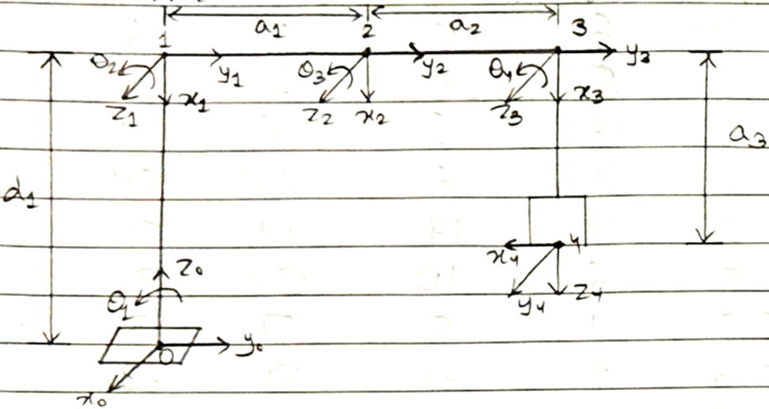
Calculation
The diagram of the robot arm with the kinematic parameters.

Slide 12
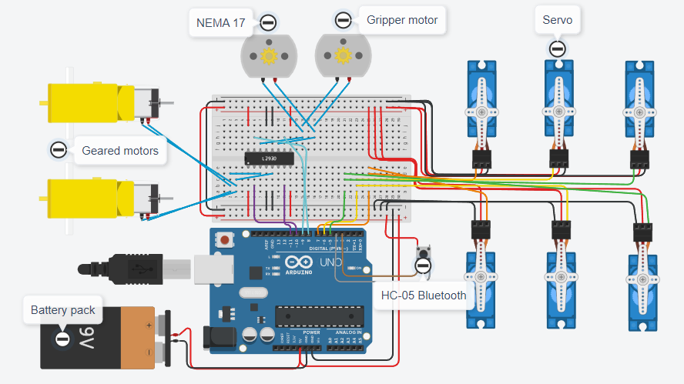
System Design

Slide 13
Challenges
Major challenges emerged at the time of making an actual model.
No. | Challenges | Solutions
1 | Lack of research available on the selected topic. | Designed the model using available research and had to consider assumptions regarding the topic.
2 | Unavailability of the required parts. | Build the robot from what was available in the market.
3 | Time consumption and delay in the assembly process. | Changed plans accordingly to adjust to complete the project on time.
4 | Motor unable to take load at one point. | Had to limit the functionality of the robot by fixing it in a particular position.
5 | Bluetooth connectivity issues and limitations of the application used. | Had to make changes in the code as per the situation incurred.

Slide 14
Results
No. | Apparatus | Status | Handling | Remark
1 | Small size test tube | Empty | Yes | Able to lift easily
2 | Medium size test tube | Empty | Yes | Able to lift easily
3 | Large size test tube | Empty | Yes | Able to lift easily
4 | Beaker | Empty | Yes | Able to lift easily
5 | Conical flask | Empty | Yes | Slight adjustment required due to shape of the object
6 | Small size test tube | Filled | Yes | Able to lift easily
7 | Medium size test tube | Filled | Yes | Able to lift easily
8 | Large size test tube | Filled | Yes | Able to lift easily
9 | Beaker | Filled | Yes | Able to lift easily
10 | Conical flask | Filled | Yes | Slight adjustment required due to shape of the object

Slide 15
Conclusion
By creating a material handling robot, equipped with an arm and handling equipment mounted on a mobile cart, we've taken a significant step towards realizing the vision of automation in medical environments. Making use of technologies like Arduino has shown us that there can be an easier and cheaper way to address such problems. This robot embodies the versatility and adaptability discussed earlier, offering a practical solution for streamlining material handling tasks within laboratories or similar facilities. As we continue to explore the diverse applications of material handling robots, including our own creation, we pave the way for a first step to introduce automation in material handling for such scenarios.

Slide 16
Further Work
The robot has scope for improvement for various applications across different industries. Here simple technology like Arduino was used to operate the robot so, suitable modifications can be made in this matter.
This robot can find its use in the field of healthcare for handling specimens and help in transporting any hazardous material. It can be used to handle even surgical instruments.
There are further many applications like automobile assembly, agriculture, packaging, e-commerce, construction, and electronics. In the end, there is much scope for usage of robots in such fields for material handling.

Slide 17
References
Bhosekar, Isık, Eksioglu, Gilstrap, Allen, “Simulation-Optimization of Automated Material Handling Systems in a Healthcare Facility,” Cornell University, June 2020, DOI: 10.48550/arXiv.2006.10031
Lu, Zhao, Huang, “Design and Implementation of Intelligent Material Handling Robot Based on STM32”, ICIIP '21: Proceedings of the 6th International Conference on Intelligent Information Processing, July 2021, Pages 242–247, DOI: 10.1145/3480571.3480614
Kolluru, Valavanis, Hebert, “Modeling, analysis, and performance evaluation of a robotic gripper system for limp material handling”, IEEE Transactions on Systems, Man, and Cybernetics, Part B (Cybernetics) Volume: 28, Issue: 3, June 1998, DOI: 10.1109/3477.678660
Bradt, Alfred, “Materials-handling systems: Automating of materials handling can integrate otherwise isolated islands of automated machine tools”, IEEE Spectrum, Volume: 20, Issue: 5, May 1983, DOI: 10.1109/MSPEC.1983.6369910
Nylander, Wallberg, Hansson, “Challenges for SMEs entering the IoT world: success is about so much more than technology”, IoT '17: Proceedings of the Seventh International Conference on the Internet of Things, Article No.: 16, Pages 1–7, October 2017, DOI: 10.1145/3131542.3131547
Kim, “Robots in Healthcare”, Interactions, Volume 30, Issue 1, Pages 48–51, January 2023, DOI: 10.1145/3575871
Eze, “Internet of Things Meets Robotics: A Survey of Cloud-based Robots”, June 2023, DOI: 10.48550/arXiv.2306.02586
Pradhan, Bharti, Chakravarty, Ray, Voinova, Bonartsev, Pal, “Internet of Things and Robotics in Transforming Current-Day Healthcare Services”, Medical Internet of Things (IoT) Devices Volume 2021, May 2021, DOI: 10.1155/2021/9999504
Villa, Song, Heim, Li, “Internet of Robotic Things: Current Technologies, Applications, Challenges and Future Directions”, January 2021, DOI: 10.48550/arXiv.2101.06256
Ponis, Efthymiou, “Cloud and IoT Applications in Material Handling Automation and Intralogistics”, September 2020, DOI: 10.3390/logistics4030022

